Slide 1
Soft-Core Processor, MIPS architecture
Subra Ganesan

Slide 2
Soft-Core and Hard-Core
A softcore processor is one which is implemented using the programmable logic resources available in the FPGA the LUT, Flip Flops and RAMS. This means it can be implemented in a wider range of devices, although they are normally vendor specific like NIOS and Microblaze.
Hardcore processors like the ARM A9 or A53 in the Zynq devices are not implemented in the logic they are hard macros which have been implemented within the silicon of the device itself just like the LUT, flip flops. You can not modify them.

Slide 3
Softcore processor may not be as fast as HardCore Processor within FPGA. But, Softcore processor allows us to add functions, add or remove instructions, add more Cache, input/output interfaces (CAN, Ethernet, etc) by software on FPGA. Whereas Hardcore already comes with a few fixed interfaces and you can not change them.
Softcore provides a substantial amount of flexibility through the configurable nature of the FPGA.
Requirements keep Changing during the development phase and it can be accommodated in Softcore.

Slide 4
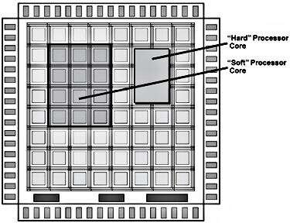

Slide 5
Soft Core Advantages and Disadvantages
Advantages
– Generally a much higher level of portability
– Generally most affordable
– More low-cost/free sources due to easier implementation
– Relatively easy to target to specific architectures
– Relatively easy to modify
Disadvantages
- Error in the Softcore design can affect performance
– Much lower level of optimization resulting in: lower performance levels, higher resource utilization
– May require more design effort
– Likely less extensive simulation results for specific architectures
– Likely less documentation for specific architectures
– Differences in tool sets used for design implementation can affect results significantly and are not always predictable

Slide 6
Hard Core inside FPGA Advantages and Disadvantages
Advantages
– Likely well-optimized for targeted architecture
– Performance, resource utilization and power consumption information generally well-characterized
– Generally provide a high level of confidence in functionality / performance
– Design already fielded and verified
– Easy to test in target environment
– Access to some level of simulation resources (testbenches and results)
– Some level of documentation available
Disadvantages
– Level of documentation, design configurability, simulation support and access to original design team may be variable
– Access to advance design assistance from IP source may be fee-for-service depending on the negotiated terms

Slide 7
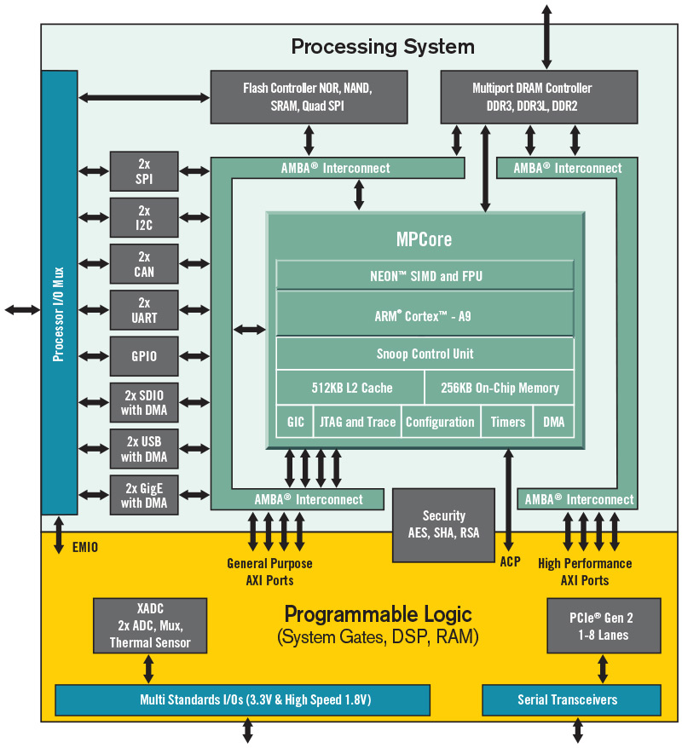

Example Soft cores are: NIOS II, Microblaze
These are free of cost to implement on FPGA
Example Hard Core in FPGA– ARM 9 in Cyclone V – SOC FPGA from Intel.
The Zynq®-7000 SoC family from Xilinx integrates acceleration while integrating CPU, DSP, ASSP, and mixed signal functionality on a single device. Consisting of single-core Zynq-7000S and dual-core Zynq-7000 devices, fully scalable SoC platform for your unique application requirements.

Slide 8
NIOS II and MIPs are similar
NIOS II is a 32 bit RISC microprocessor very similar to MIPS processor.
It is a soft core processor implementation code is available for free from Intel.
All instructions are typically of one size
Few instruction formats
Arithmetic instructions are register to register
  Operands are read from registers
  Result is stored in a register
General purpose integer and floating point registers
  Typically, 32 integer and 32 floating-point registers
Memory access only via load and store instructions
  Load and store: bytes, half words, words, and double words
Few simple addressing modes

Slide 9
Logical View of the MIPS Processor
. . .
4 bytes per word
Memory
Up to 2³² bytes = 2³⁰ words
. . .
EIU
$0
Execution &
Integer Unit
(Main proc)
FPU
$F0
Floating
Point Unit
(Coproc 1)
32 General
Purpose
Registers
$1
$F1
$2
$F2
32 Floating-Point
Registers
Arithmetic &
Logic Unit
$31
Integer
FP
$F31
ALU
mul/div
Arith
Floating-Point
Arithmetic Unit
Hi
Lo
TMU
BadVaddr
Trap &
Memory Unit
(Coproc 0)
Status
Integer Multiplier/Divider
Cause
EPC

Slide 10
Overview of the MIPS Registers
32 General Purpose Registers (GPRs)
  32-bit registers are used in MIPS32
  Register 0 is always zero
  Any value written to R0 is discarded
Special-purpose registers LO and HI
  Hold results of integer multiply and divide
Special-purpose program counter PC
32 Floating Point Registers (FPRs)
  Floating Point registers can be either 32-bit or 64-bit
  A pair of registers is used for double-precision floating-point
GPRs
$0 – $31
LO
HI
PC
FPRs
$F0 – $F31

Slide 11
MIPS General-Purpose Registers
32 General Purpose Registers (GPRs)
  Assembler uses the dollar notation to name registers
    $0 is register 0, $1 is register 1, …, and $31 is register 31
  All registers are 32-bit wide in MIPS32
  Register $0 is always zero
    Any value written to $0 is discarded
Software conventions
  Software defines names to all registers
    To standardize their use in programs
  $8 - $15 are called $t0 - $t7
    Used for temporary values
  $16 - $23 are called $s0 - $s7
$0 = $zero
$16 = $s0
$1 = $at
$17 = $s1
$2 = $v0
$18 = $s2
$3 = $v1
$19 = $s3
$4 = $a0
$20 = $s4
$5 = $a1
$21 = $s5
$6 = $a2
$22 = $s6
$7 = $a3
$23 = $s7
$8 = $t0
$24 = $t8
$9 = $t1
$25 = $t9
$10 = $t2
$26 = $k0
$11 = $t3
$27 = $k1
$12 = $t4
$28 = $gp
$13 = $t5
$29 = $sp
$14 = $t6
$30 = $fp
$15 = $t7
$31 = $ra

Slide 12
Instruction Formats
All instructions are 32-bit wide, Three instruction formats:
Register (R-Type)
  Register-to-register instructions
  Op: operation code specifies the format of the instruction
Immediate (I-Type)
  16-bit immediate constant is part in the instruction
Jump (J-Type)
  Used by jump instructions
Op⁶
Rs⁵
Rt⁵
Rd⁵
sa⁵
funct⁶
Op⁶
Rs⁵
Rt⁵
immediate¹⁶
Op⁶
immediate²⁶

Slide 13
Instruction Categories
Integer Arithmetic
  Arithmetic, logical, and shift instructions
Data Transfer
  Load and store instructions that access memory
  Data movement and conversions
Jump and Branch
  Flow-control instructions that alter the sequential sequence
Floating Point Arithmetic
  Instructions that operate on floating-point registers
Miscellaneous
  Instructions that transfer control to/from exception handlers
  Memory management instructions

Slide 14
Addressing Modes
Where are the operands?
How memory addresses are computed?
Immediate Addressing
Op⁶
Rs⁵
Rt⁵
immediate¹⁶
Operand is a constant
Register Addressing
Op⁶
Rs⁵
Rt⁵
Rd⁵
sa⁵
funct⁶
Operand is in a register
Register
Base or Displacement Addressing
Operand is in memory (load/store)
Op⁶
Rs⁵
Rt⁵
immediate¹⁶
Word
+
Halfword
Byte
Register = Base address

Slide 15
Branch / Jump Addressing Modes
Used for branching (beq, bne, …)
PC-Relative Addressing
Op⁶
Rs⁵
Rt⁵
immediate¹⁶
+1
Word = Target Instruction
PC³⁰
00
Target Instruction Address
PC = PC + 4 × (1 + immediate¹⁶)
PC³⁰ + immediate¹⁶ + 1
00
Used by jump instruction
Pseudo-direct Addressing
Op⁶
immediate²⁶
:
Word = Target Instruction
PC⁴
PC²⁶
00
Target Instruction Address
PC⁴
immediate²⁶
00

Slide 16
Jump and Branch Limits
Jump Address Boundary = 2²⁶ instructions = 256 MB
  Text segment cannot exceed 2²⁶ instructions or 256 MB
  Upper 4 bits of PC are unchanged
Branch Address Boundary
  Branch instructions use I-Type format (16-bit immediate constant)
  PC-relative addressing:
    Target instruction address = PC + 4×(1 + immediate¹⁶)
    Count number of instructions to branch from next instruction
    Positive constant => Forward Branch, Negative => Backward branch
    At most ±2¹⁵ instructions to branch (most branches are near)
Target Instruction Address
PC⁴
immediate²⁶
00
PC³⁰ + immediate¹⁶ + 1
00

Slide 17
Alternative Architecture
Design alternative:
  Provide more complex instructions
  Goal is to reduce number of instructions executed
  Danger is a slower cycle time and/or a higher CPI
Let’s look briefly at IA-32 (Intel Architecture - 32 bits)
  An architecture that is “difficult to explain and impossible to love”
  Developed by several independent groups
  Evolved over more than 20 years
  History illustrates impact of compatibility on the ISA

Slide 18
The Intel x86 ISA
Evolution with backward compatibility
  8080 (1974): 8-bit microprocessor
    Accumulator, plus 3 index-register pairs
  8086 (1978): 16-bit extension to 8080
    Complex instruction set (CISC)
  8087 (1980): floating-point coprocessor
    Adds FP instructions and register stack
  80286 (1982): 24-bit addresses, MMU
    Segmented memory mapping and protection
  80386 (1985): 32-bit extension (now IA-32)
    Additional addressing modes and operations
    Paged memory mapping as well as segments

Slide 19
The Intel x86 ISA
Further evolution…
  i486 (1989): pipelined, on-chip caches and FPU
    Compatible competitors: AMD, Cyrix, …
  Pentium (1993): superscalar, 64-bit datapath
    Added MMX (Multi-Media eXtension) instructions
    The infamous FDIV bug
  Pentium Pro (1995), Pentium II (1997)
    New microarchitecture (see Colwell, The Pentium Chronicles)
  Pentium III (1999)
    Added SSE (Streaming SIMD Extensions) and registers
  Pentium 4 (2001)
    New microarchitecture
    Added SSE2 instructions

Slide 20
The Intel x86 ISA
And further…
  AMD64 (2003): extended architecture to 64 bits
  EM64T – Extended Memory 64 Technology (2004)
    AMD64 adopted by Intel (with refinements)
    Added SSE3 instructions
  Intel Core (2006)
    Added SSE4 instructions, virtual machine support
  AMD64 (announced 2007): SSE5 instructions
    Intel declined to follow, instead…
  Advanced Vector Extension (announced 2008)
    Longer SSE registers, more instructions
Technical elegance ≠ market success

Slide 21
Summary of Design Principles
Simplicity favors regularity
  Simple instructions dominate the instruction frequency
    So design them to be simple and regular, and make them fast
    Use general-purpose registers uniformly across instructions
  Fix the size of instructions (simplifies fetching & decoding)
  Fix the number of operands per instruction
    Three operands is the natural number for a typical instruction
Smaller is faster
  Limit the number of registers for faster access (typically 32)
Make the common case fast
  Include constants inside instructions (faster than loading them)
  Design most instructions to be register-to-register
Good design demands good compromises
  Smaller immediate constants in I-type instructions

